Slide 1
Memory Management and Virtual Memory in Windows XP / 7 / 8
By Eric Beilmann

Slide 2
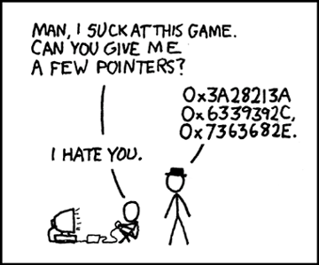

Slide 3
Executive Services
The Basic components of the Windows OS
Virtual Memory Manager
Local Procedure Call Facility (mostly about IPCs, wont be covered)
Process Manager
Object Manager
Security Reference Monitor

Slide 4
1. Virtual Memory Manager
Takes charge of physical memory installed on a computer and dynamically allocates it to individual processes as-needed
Controls how a process functions and uses resources
32-bit Windows XP supports addressing up to 4GB (Page Directory Offset (10 bits) Page Table Offset (10 bits) Page Frame Offset (12 bits))
Translates between a processes virtual address and the address used by its physical memory
Does TLB inserts
Uses a page frame database to keep track of what is in physical memory (discussed more on future slides)
The non-paged pool are pages that are always in physical memory. This includes scheduling information, references to files, I/O Request Packets (represent I/O operations), and a few other things. This is an important part for handling page faults

Slide 5
page frame database
This is organized as a set of linked lists based on their status.
Status of pages:
Valid – the page is in use by an active process
Modified – page was written to but not written to the paging file
Standby – the page has been removed from the processes working set
Free – page is free to use after it has been zeroed (unless it is read-only)
Zeroed – A page is ready for use by any process
Bad – A page that caused a hardware error

Slide 6
page frame database cont.
When the VMM needs to find consecutive free pages for a process it follows the linked list of pages that are in the free state
When the VMM needs to write a page of data out to a paging file to make room for another page to be swapped in it looks for the modified pages

Slide 7
Resident Set Management Scheme
Variable allocation with a local scope
When memory is plentiful: The VMM allows resident sets to grow
When memory is scarce: The VMM recovers memory by removing less recently used pages out of the working set

Slide 8
Placement and Replacement policies
Placement: Combination of local and global placement. It primarily uses a local policy but when it is needed they use a global policy.
Replacement: is based on working sets which removes pages with a Least Recently Used (LRU) policy.

Slide 9
Linking
Uses run-time dynamic linking
When A call is made to an absent module the operating system locates the module, loads it, and links it to the calling module.
These sharable modules are called Dynamic Link Libraries(DLLs)
DLL hell:
Sometimes older versions of a module will be reinstalled

Slide 10
3. Process Manager
Responsible for creating and terminating necessary memory structures and starting up threads of a process.
Implements concept of a job
Job objects are a group of processes that can be terminated as a whole or placed under shared restrictions (limits to total memory allocation or CPU time). A process can be a member of only one job object.

Slide 11
4. Object Manager
Objects are the basic units that can be managed by the executive
All other executive subsystems must pass through the object manager to gain access to windows resources
To the object manager each resource is an object. Whether it is a physical resource (file system or peripheral) or a logical resource (a file)

Slide 12
5. Security Reference Monitor (SRM)
System wide data structures and memory pools used by kernel mode system components can only be accessed in kernel mode
Each process has a separate, private address space
Hardware controlled memory protection(ex: read / write, read-only)
Shared memory section objects have standard access control lists (ACLs) that are checked when processes attempt to open them

